Slide 1
Reactive Programming
Spring Boot

Slide 2
What is Reactive Programming?
Reactive programming is a programming paradigm that promotes an asynchronous, non-blocking, event-driven approach to data processing. Reactive programming involves modeling data and events as observable data streams and implementing data processing routines to react to the changes in those streams.

Slide 3
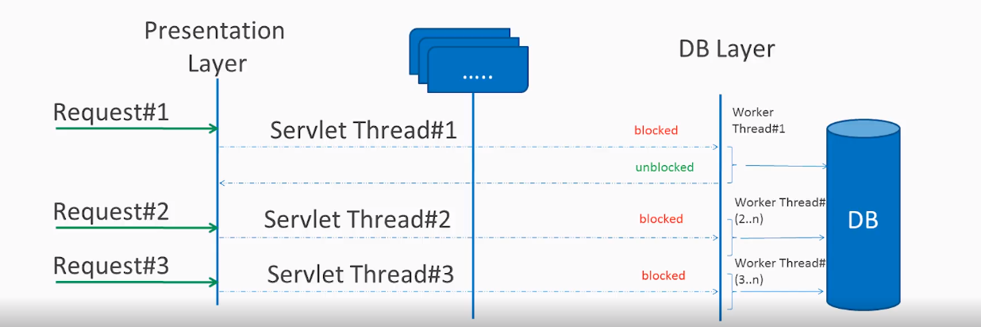














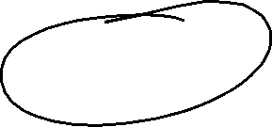
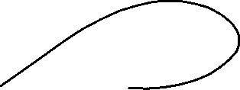




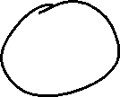


Synchronous/Blocking Request Processing
In traditional MVC applications, when a request come to server, a servlet thread is created. It delegates the request to worker threads for I/O operations such as database access etc. During the time worker threads are busy, servlet thread (request thread) remain in waiting status and thus it is blocked. It is also called synchronous request processing.
As server can have some finite number of request threads, it limits the server capability to process that number of requests at maximum server load. It may hamper the performance and limit the full utilization of server capability.

Slide 4
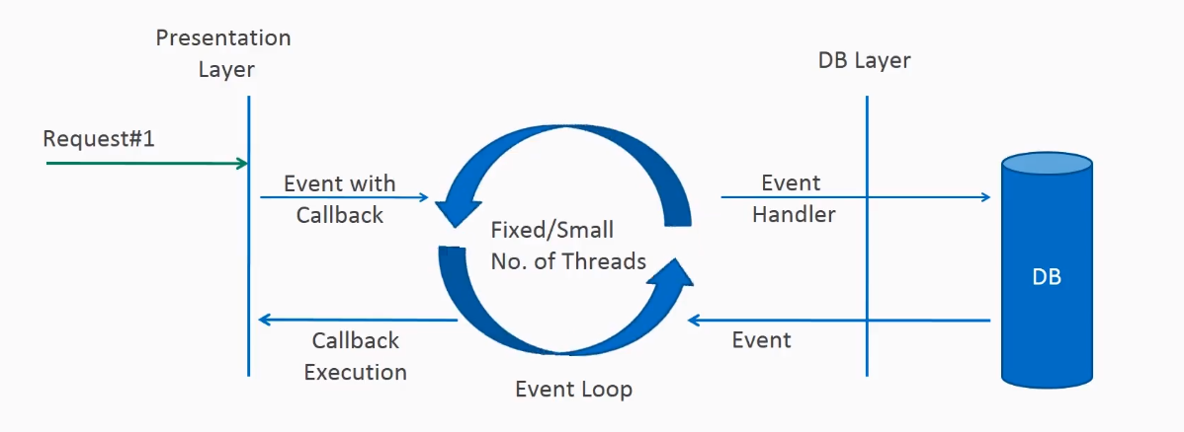



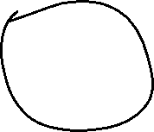


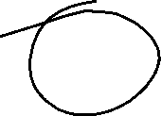



Non-blocking Request Processing
In non-blocking or asynchronous request processing, no thread is in waiting state. There is generally only one request thread receiving the request.
All incoming requests come with a event handler and call back information. Request thread delegates the incoming requests to a thread pool (generally small number of threads) which delegate the request to it’s handler function and immediately start processing other incoming requests from request thread.
When the handler function is complete, one of thread from pool collect the response and pass it to the call back function.

Slide 5

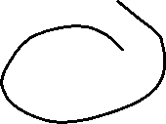




What is Reactive Programming
The term, “reactive,” refers to programming models that are built around reacting to changes. It is build around publisher-subscriber pattern (observer pattern). In reactive style of programming, we make a request for resource and start performing other things. When the data is available, we get the notification along with data inform of call back function. In callback function, we handle the response as per application/user needs.
One important thing to remember is back pressure. In non-blocking code, it becomes important to control the rate of events so that a fast producer does not overwhelm its destination.
Reactive web programming is great for applications that have streaming data, and clients that consume it and stream it to their users. It is not great for developing traditional CRUD applications. If you’re developing the next Facebook or Twitter with lots of data, a reactive API might be just what you’re looking for.

Slide 6

















Reactive Streams API
Reactive Streams is a small spec (also adopted in Java 9) that defines the interaction between asynchronous components with back pressure. For example, a data repository (acting as a Publisher) can produce data that an HTTP server (acting as a Subscriber) can then write to the response. The main purpose of Reactive Streams is to let the subscriber control how quickly or how slowly the publisher produces data.
Project Reactor is the reactive library of choice for Spring Data R2DBC. It provides the Mono and Flux API types to work on data sequences of 0..1 (Mono) and 0..N (Flux) through a rich set of operators aligned with the ReactiveX vocabulary of operators. Reactor is a Reactive Streams library, and, therefore, all of its operators support non-blocking back pressure. Reactor has a strong focus on server-side Java. It is developed in close collaboration with Spring.

Slide 7
Spring WebFlux supports the Reactive Stream API, which is a standardized tool for processing asynchronous streams with non-blocking backpressure. Backpressure is a way of dealing with a data stream that may be too large to be reliably processed. In other words, backpressure refers to the ability to request data when the consumer is ready to process them.
Reactive streams have a publisher (producer) — subscriber (consumer) model. The publisher emits an event and a subscriber will read it. In the Reactive Streams API there are four main interfaces:
Publisher — Emits events to subscribers based on the demands received from its subscribers. A publisher can serve multiple subscribers and it has only one method: subscribe
Subscriber — Receives events emitted by the Publisher. The subscribe has four methods to deal with the events received: onSubscribe, onNext, onError and onComplete
Subscription — Represents the relationship between the subscriber and the publisher. It has methods that allow requesting for data request(long n) and to cancel the demand of events cancel()
Processor — Publisher and subscriber at the same time; rarely used.
Spring WebFlux internally uses Project Reactor and its publisher implementations, Flux and Mono.
Mono — A publisher that can emit 0 or 1 element.
Flux — A publisher that can emit 0..N elements.

Slide 8
Publisher: Emits a sequence of events to subscribers according to the demand received from its subscribers
Publisher.java
public interface Publisher<T> { public void subscribe(Subscriber<? super T> s); }

Slide 9
Subscriber: Receives an processes events emitted by a Publisher. Please note that no notifications will be received until Subscription#request(long) is called to signal the demand.
Subscriber.java
public interface Subscriber<T> { public void onSubscribe(Subscription s); public void onNext(T t); public void onError(Throwable t); public void onComplete(); }

Slide 10
Subscription: Defines a one-to-one relationship between a Publisher and a Subscriber. It can only be used once by a single Subscriber. It is used to both signal desire for data and cancel demand (and allow resource cleanup).
Subscription.java
public interface Subscription<T> { public void request(long n); public void cancel(); }
Processor: Represents a processing stage consisting of both a Subscriber and a Publisher and obeys the contracts of both.
Processor.java
public interface Processor<T, R> extends Subscriber<T>, Publisher<R> { }
two popular implementations of reactive streams are RxJava (https://github.com/ReactiveX/RxJava) and Project Reactor (https://projectreactor.io/).

Slide 11
What is R2DBC?
R2DBC is the acronym for Reactive Relational Database Connectivity. R2DBC is an API specification initiative that declares a reactive API to be implemented by driver vendors to access their relational databases.
JDBC is a blocking API, which means that when a request is made, it remains busy until the response is provided. R2DBC, by contrast, is non-blocking, which means requests can be made and responded to while others are pending.

Slide 12
@GetMapping(value="/sayfluxagain",produces = MediaType.TEXT_EVENT_STREAM_VALUE )
public Flux<Integer> sayHelloFluxAgain()
{
return Flux.just(1,2,3,4)
.delayElements(Duration.ofSeconds(1))
.log();
}

